Slide 1


WiFi: Posit Conf 2023 Password: conf2023

Slide 2
Information
WiFi: Posit Conf 2023
Password: conf2023
There are gender-neutral bathrooms located are among the Grand Suite Bathrooms.
There are two meditation/prayer rooms
Grand Suite 2A and Grand Suite 2B
Open Sunday - Tuesday 7:30 a.m. - 7:00 p.m., Wednesday 8:00 a.m. - 6:00 p.m.
The lactation room is located in Grand Suite 1.
Sunday - Tuesday 7:30 a.m. - 7:00 p.m., Wednesday 8:00 a.m. - 6:00 p.m.

Slide 3
Conduct
Participants who do not wish to be photographed have red lanyards; please note everyone's lanyard colors before taking a photo and respect their choices.
The Code of Conduct and COVID policies can be found at: https://posit.co/code-of-conduct/.
Please review them carefully.
You can report Code of Conduct violations in person, by email, or by phone. Please see the policy linked above for contact information.

Slide 4
What to expect from this workshop
Learn about R packages to support Clinical Reporting in R
Create ADaM datasets,
Prepare ARD’s and Displays
Interactive shiny apps
Hands-on exercises
How to contribute back to the Pharmaverse!

Slide 5

Workshop Expectations
What to do if you find a ?
Ask questions
Be respectful to each other and yourself

Slide 6
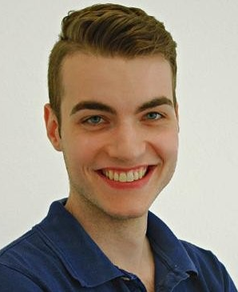
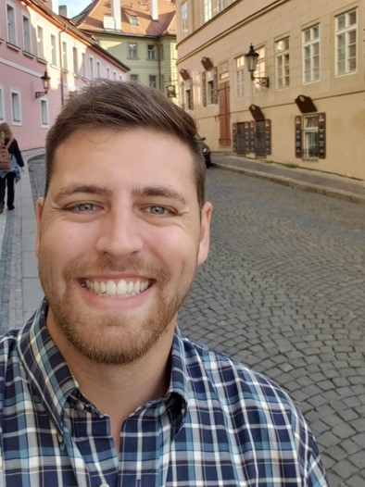
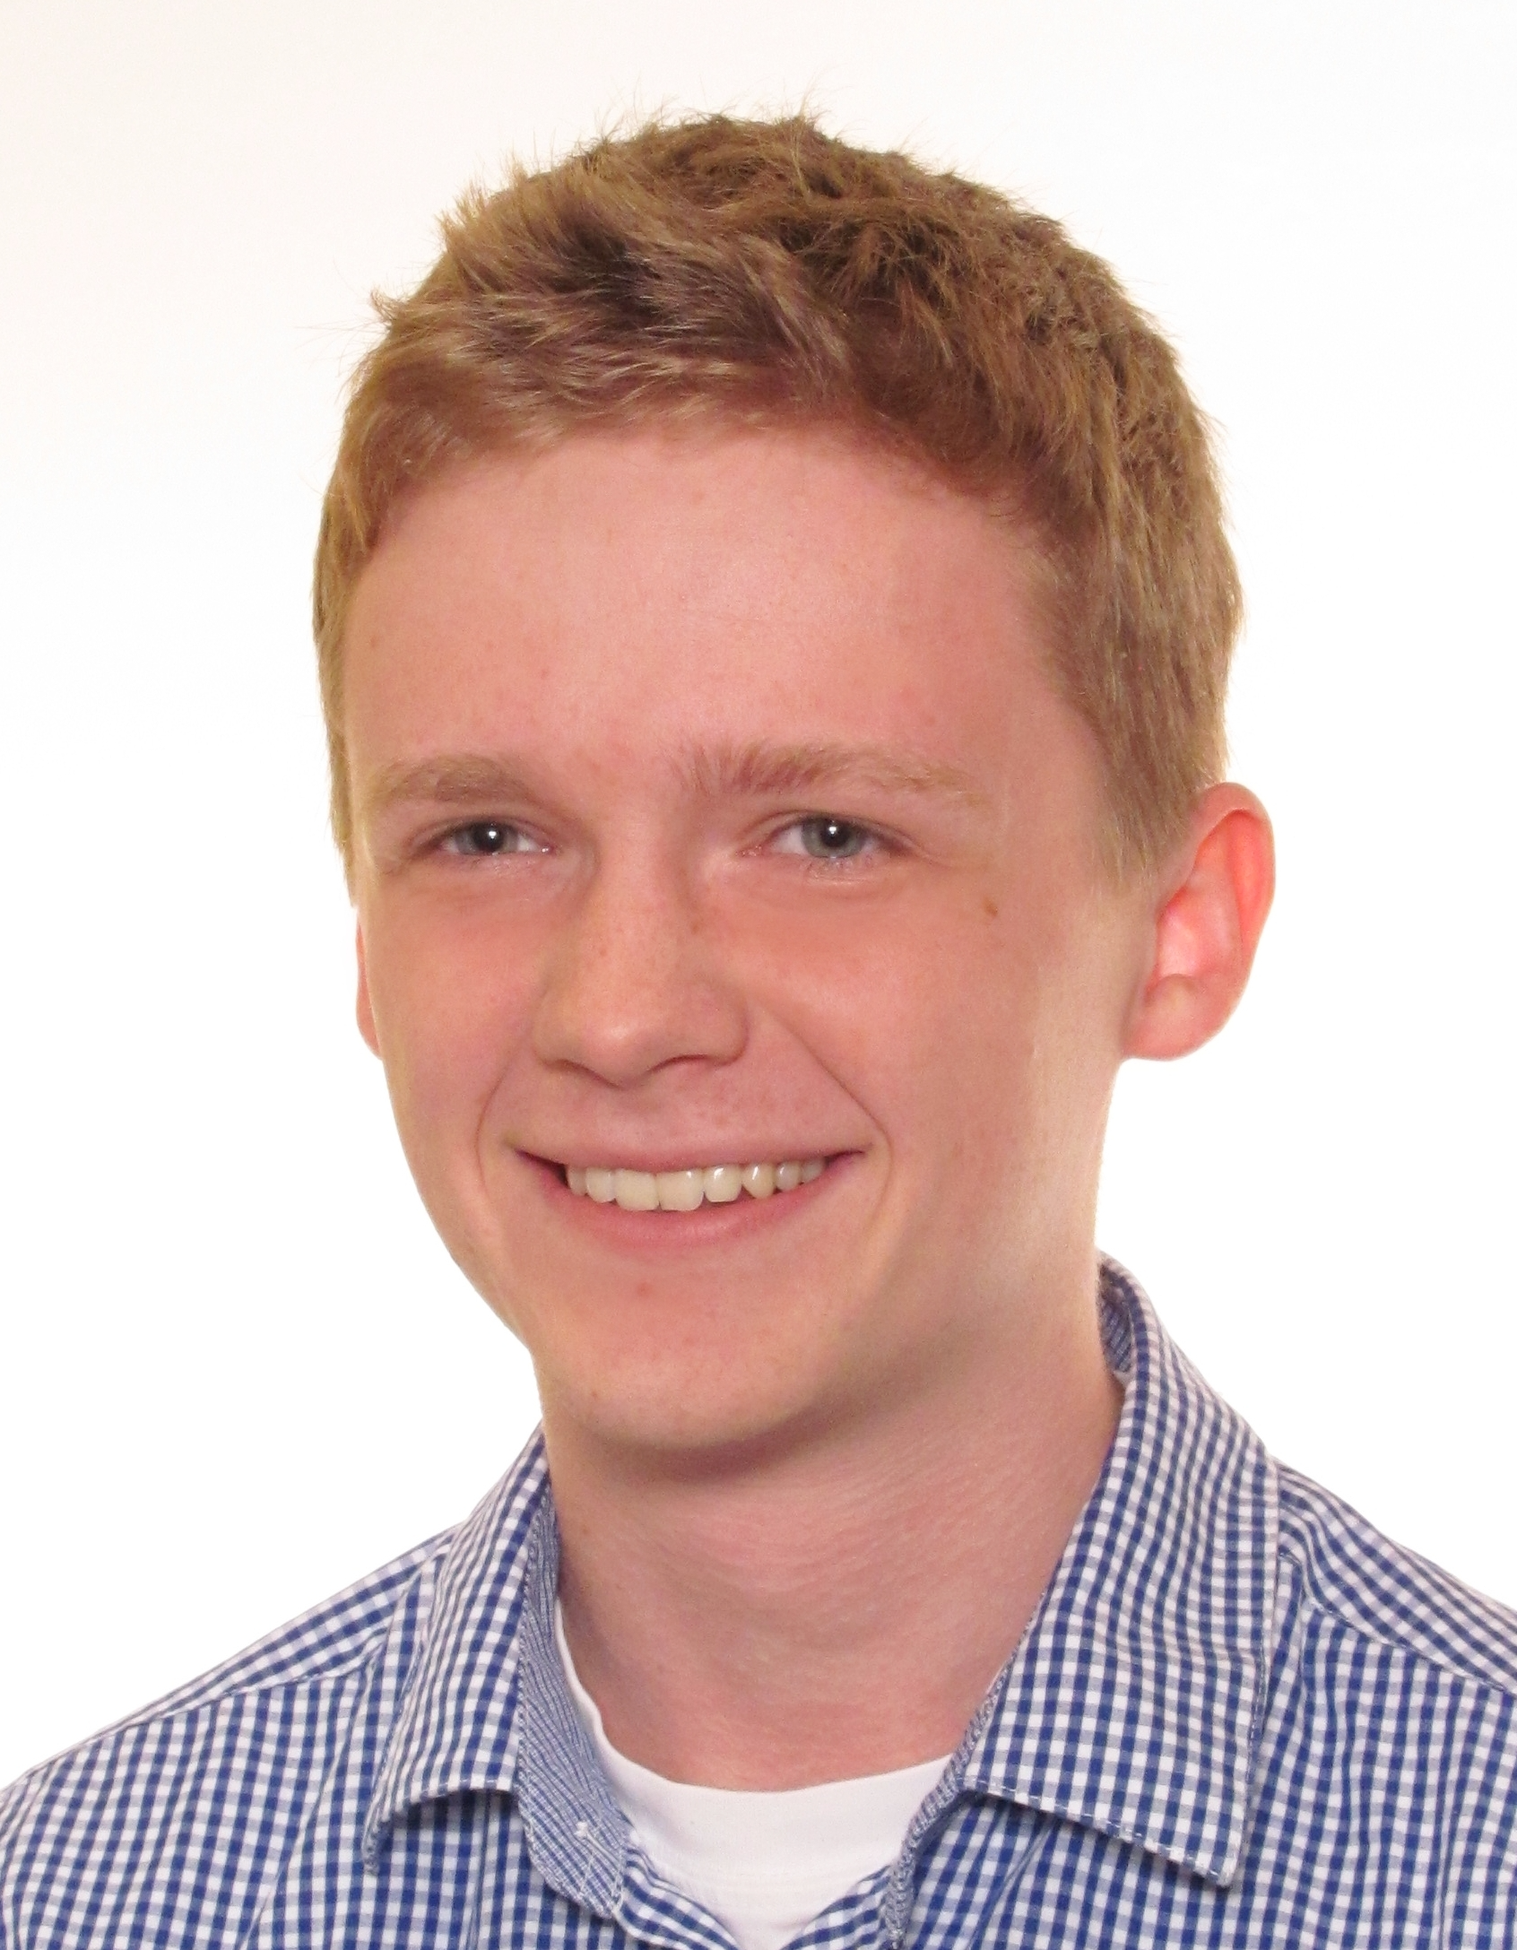
Workshop Instructors
Who are we?
What do we do?
Why are we here?
Ellis Hughes
Thomas Neitmann
Pawel Rucki

Slide 7

Who are you?!
Meet the people around you!

Slide 8

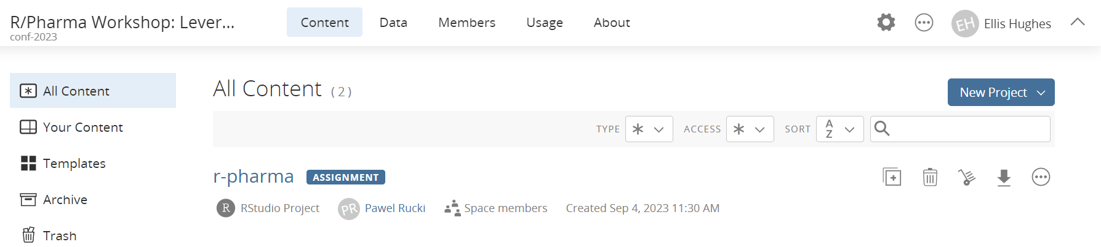
Our environment
For consistency, we’ll be working in RStudio Cloud
We’ve installed and configured everything for you
Following the course, all content from this workshop will be available on GitHub (https://github.com/posit-conf-2023/r-pharma)

Slide 9
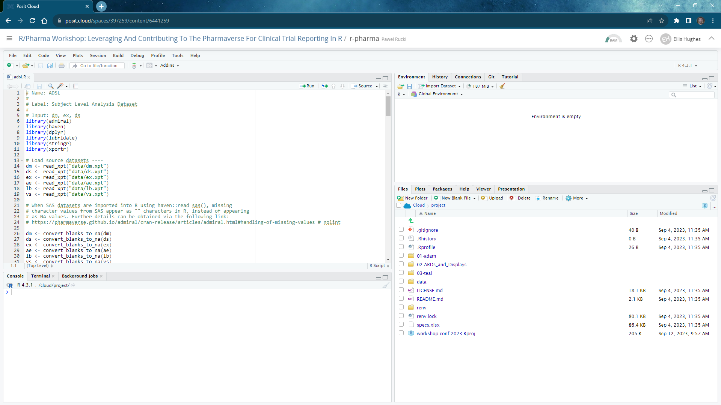

Slide 10
Edit Window/Source

Slide 11
Console

Slide 12
File Pane

Slide 13
Plot Pane

Slide 14
Help Pane

Slide 15
Environment

Slide 16
Time | Activity
09:00 – 09:10 | Introduction
09:10 - 10:30 | Session 1 - ADaM
10:30 - 11:00 | Coffee break
11:00 - 12:30 | Session 2 – ARDs and Displays
12:30 - 13:30 | Lunch break
13:30 - 15:00 | Session 3 - teal
15:00 - 15:30 | Coffee break
15:30 - 17:00 | Session 4 - Contributing

